Slide 1
Adaptive Transportation In-Service for OTs, PTs, and Hospital Personnel
Your name and affiliation
Date and location
Notes:
FYI Updated 12/2022
This in-service was developed by the National Center for the Safe Transportation of Children With Special Health Care Needs in conjunction with Safe Kids Worldwide. Funding for the project was provided by Safe Kids Worldwide and Children’s National Health System, in Washington, DC.
It can be taught by any certified child passenger safety technician who has an interest in adaptive transportation.
This presentation will take 45 – 60 minutes and provide participants with a general awareness of adaptive transportation, along with some resources to help them take the necessary next steps.
In preparation, please review all of the forms and documents in the tool kit and the sections that address adaptive transportation in your Technician Guide or the Safe Travel for All Children Resource Manual. You may also contact the National Center if you have questions (800-755-0912).
Refer to the Instructor Guidelines document in the tool kit for more details on preparing for and teaching this in-service.
Add your name, affiliation, date and location of the training to the title slide.

Slide 2
Objectives
Identify types of medical conditions that may require special consideration
State three benefits of using conventional restraints whenever possible
Identify four types of adaptive restraints
Identify local and national adaptive resources
Learn about training required to become certified child passenger safety technician (CPST) and additional adaptive transportation training
Notes:
Review objectives with participants.

Slide 3
Background
Gap in resources for children with special health care needs
Impact of medical, physical, or behavioral conditions on how a child and family travels
Safe access to services and communities important for all children
Options available to improve transportation of children with special health care needs
Relative improvement of child safety during transportation despite fragility and uncertain tolerance for injury
Notes:
FYI
As child passenger safety was emerging as an important initiative in the 1980’s, safety advocates recognized a gap in protection for children with special health care needs. Restraints were limited or non-existent for children who had medical, physical or behavioral conditions that impacted how they traveled.
Since then, the number of restraint options available for children with special health care needs have grown dramatically, allowing children with special health care needs and their families the ability to access services and their communities.
A child with special health care needs may not receive the same level of protection from a restraint as a typically developing child. For example, a toddler who in a hip cast and has to travel lying down in a modified E-Z-ON vest will not be as protected as a child in a rear-facing car seat. A child with poor head and neck control will not receive the same level of protection from a forward facing car seat as a child who has good head and neck control. Compared to riding unrestrained in a cardboard box on the floor of a vehicle or being held in arms or riding on a reclined vehicle seat, the relative improvements have greatly benefitted the lives of children and their families.

Slide 4
Challenges
Lack of awareness about resources and transportation recommendations
Lack of comprehensive inpatient and outpatient child passenger safety services
Insufficient trainings for families, staff, vendors
Limited funding
Lack of comprehensive hospital discharge policies
Concerns about liability
Compromised occupant protection in school buses and ambulances
These challenges not insurmountable!
Notes:
FYI
This slide highlights some of the major challenges associated with transporting children with special health care needs.
Due to advances made in adaptive transportation over the last few decades, these challenges can be overcome.

Slide 5
Liability
Liability is a frequent concern in medical care
Provision of appropriate car seats in hospitals along with necessary education is medically necessary
Significant liability when fail to provide appropriate education and/or resources
Minimize liability with appropriate policies, protocols, and documentation
Risk Management should be included from beginning in policy and protocol development
Notes:
FYI
Hospitals may be hesitant to incorporate adaptive transportation practices due to concerns about liability. However, failure to provide appropriate education and/or resources can increase the risk of liability.
Provide participants with a copy of the CHECKLIST FOR HOSPITAL DISCHARGE RECOMMENDATIONS FOR SAFE TRANSPORTATION OF CHILDREN, which is in your toolkit.
If you would like a better understanding of ways to minimize liability, view “A Discussion on Liability for the Person Conducting Community Education Programs,”
a National CPS Board You-Tube series at www.cpsboard.org. Please share the website with participants.

Slide 6
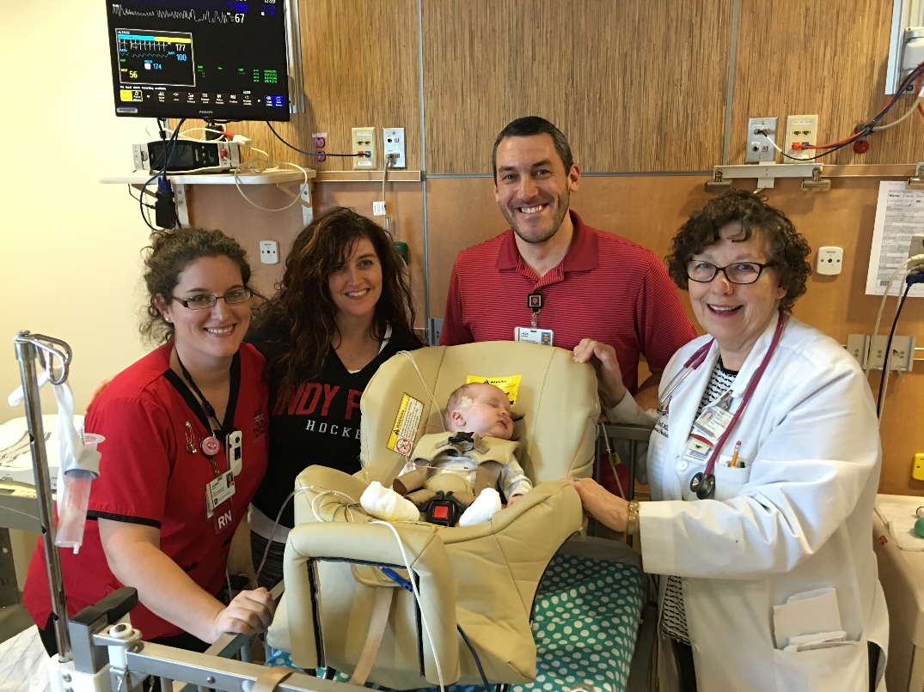
Multidisciplinary Team Approach
Use a multidisciplinary approach to involve the family, child’s medical team, child passenger safety technicians, school staff, social workers, durable medical equipment vendors (DME), etc.
L-R: nurse, mother, baby, occupational therapist,
and pediatrician
Source: Automotive Safety Program
Notes:
It’s important to involve everyone who plays a role in caring for a child in discussions about transportation options.
This photo shows (l-r) the baby’s nurse, mom, occupational therapist and pediatrician. The occupational therapist and pediatrician are also certified child passenger safety technicians.

Slide 7
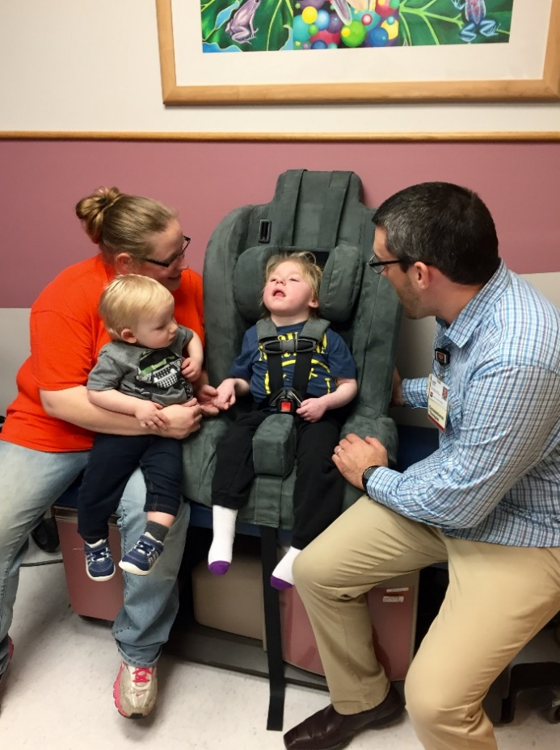
Rehabilitation Therapists
Occupational therapists and physical therapists
Offer individualized positioning guidelines for car seat
Enhance participation in everyday activities by providing safe transportation options
Able to bill for services
Occupational therapist positioning child in large medical seat
Source: Automotive Safety Program
Notes:
FYI
Rehabilitation therapists, including occupational therapists and physical therapists, are responsible for assessing a child’s physical capabilities and determining ways to improve a child’s interaction with their environment. They are essential members of a child’s medical team and often work with children who have involved positioning needs. An occupational therapist or physical therapist can offer individualized positioning guidelines if questions arise regarding how to position a child in a child safety seat.
Some hospital-based car seat programs utilize therapists who are certified child passenger safety technicians. Involvement by therapists allows a car seat program to offer more comprehensive services to a wider age range of children, in both inpatient and outpatient settings. Therapists are able to bill third-party payers such as private insurance and Medicaid for their services.

Slide 8
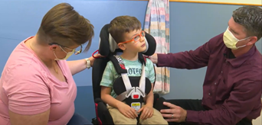
Restraint Selection Factors
Height and weight
Numeric age and developmental age
Medical diagnosis or procedures
Requirements during travel:
  Flat? Side lying?
  On back? On stomach?
  Bend at hips?
  Sit unsupported?
  Escaping/unbuckling?
Source: Automotive Safety Program
Notes:
Explain that it is not always necessary to know a child’s medical condition or diagnosis. However, it is necessary to know how a child must be positioned during transport.
Once the recommended position is identified, restraints that are capable of accommodating the child’s needs can be considered.
Please note: This is not a safe sleep position shown in this photo.
FYI
For example, can the child tolerate sitting in a semi-upright position; does the child have to lie flat and if so, on the child’s back (supine), stomach (prone) or side?
Due to concerns of SIDS, babies should only be positioned prone in a car bed when medically necessary and on the advice/order of a physician.
There are very few options that allow a child to travel side-lying: the Angel Ride car bed, Hope car bed, and modified EZ-ON vest.
Is an older child able to sit upright forward facing without extra support?

Slide 9
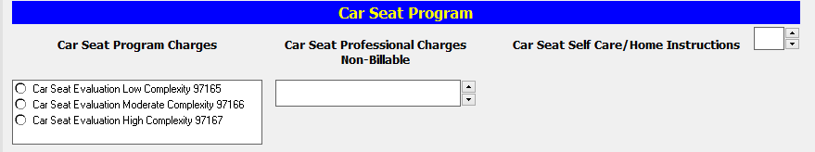
Billing
Screen shot of electronic billing record
Essential to operating an adaptive car seat program
Completed by OT or PT
CPT codes generate billing
  Initial evaluation based on patient complexity
  Return visit billed as Self Care/Home Instruction
Notes:
Explain that the section highlighted in red gives the specific code number after the description of services. If the evaluation codes can’t be seen well enough, they are as follows:
Low Complexity 97165 OT code / 97161 PT code
Medium Complexity 97166 OT code / 97162 PT code
High Complexity 97167 OT code / 97163 PT code
Self Care/Home Instruction 97535 OT code & PT code
Re-Evaluation 97168 OT code / 97164 PT code
FYI
CPT codes are universal and communicate uniform information about medical services and procedures to health care payers. They identify services rendered rather than patient diagnoses.
Without these codes, health care providers would have a hard time getting paid for their services. This is one reason why many hospital car seat programs utilize therapists who are CPSTs.
CPT stands for Current Procedural Terminology.

Slide 10
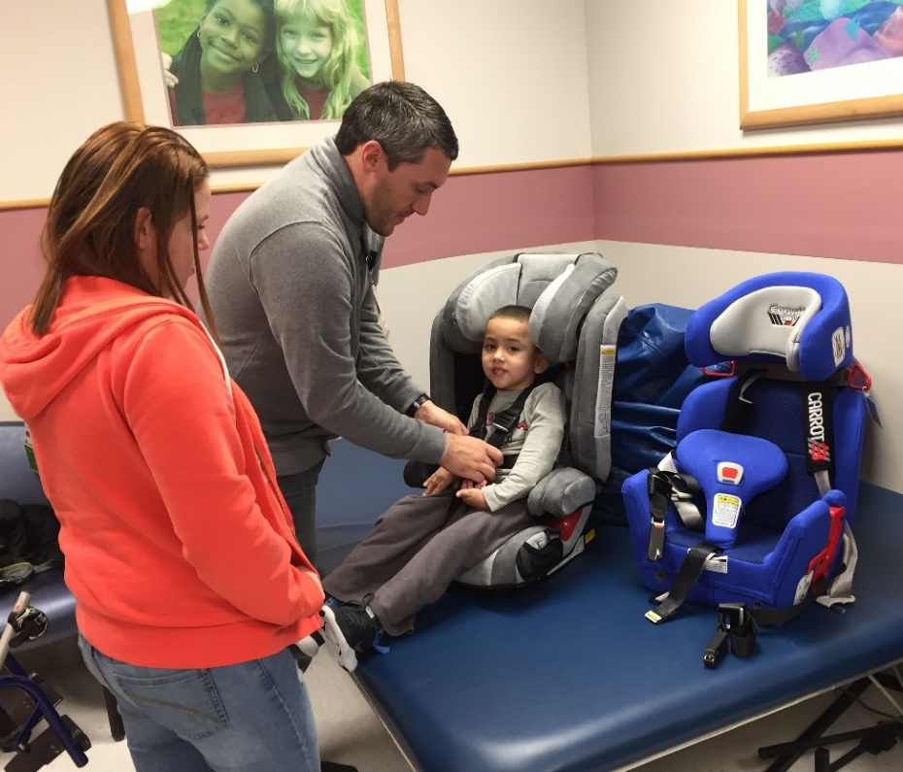
Restraint Selection Factors
Optimal safety and positioning
Availability and/or affordability of restraints
Family vehicles
Other occupants
Family choices
Source: Automotive Safety Program
Notes:
FYI
A restraint selected should provide a child with optimal safety and positioning.
Adaptive restraints can be cost-prohibitive for families if not approved by third party payers (private insurance or Medicaid). Although a conventional restraint that offers extra padding or multiple recline angles might be appropriate, it can be too expensive for a family to purchase or for a hospital to provide.
The vehicle might be too small to install a large medical seats or a modified EZ ON vest or lack working seat belts or adequate tether anchors. Large medical seats must be installed with a tether system, requiring tether anchors in the vehicle. Some require installation of heavy duty tether anchors in the vehicle when a child reaches a certain weight.
The family’s vehicle may not have enough room for all occupants if the adaptive restraint requires more than one seating space.
Proper restraint of all occupants should be taken into consideration so that everyone in the vehicle is properly restrained.
The family’s choice of seat should be taken into consideration, unless choice could affect the child’s safety. If a family is not comfortable with a seat, they could be less likely to use it correctly.

Slide 11
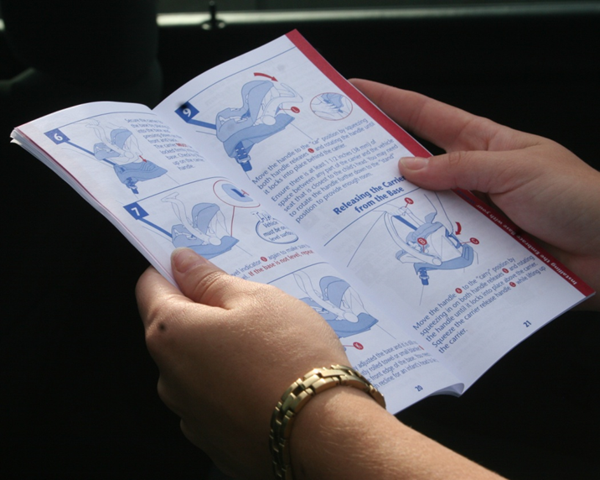
Restraint Options
Conventional or adaptive restraints
Never modify structure of any restraint to make it fit child
Modifications impact safety
Never add any non-regulated products to a restraint
Always read and follow instructions for restraint and manual for vehicle
Notes:
Explain that two categories of restraint options will be covered in the in-service: conventional restraints and adaptive restraints. Each category will be discussed in more detail.
Instructions are specific to models of car seats and vehicles and are not interchangeable with other instructions.
FYI
Some hospital personnel may be tempted to change the structure of a restraint by adding or removing items so that it fits a child better. For example, rehabilitation therapists who are trained to adapt products so that a child can better interact with his environment may be unaware of the detrimental effect adaptations can have on how a restraint performs in a crash.

Slide 12
Conventional Car Seats
Notes:
This is just a section header slide.

Slide 13
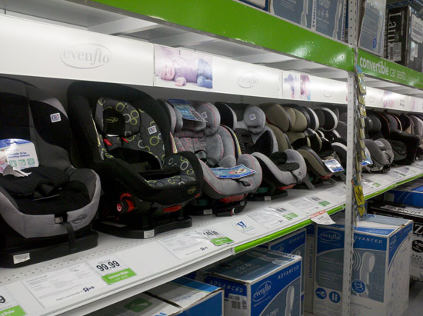
Conventional Car Seats
Use whenever possible
  Easier to find
  Easier to use
  Less expensive
Meet Federal Motor Vehicle Safety Standards (FMVSS)
May have variety of features to assist in positioning

Slide 14
Types of Conventional Car Seats
Rear-Facing Only
Convertible (includes All-in-One)
Combination
Booster
Notes:
FYI
This slide only lists the types of car seats. Each type of car seat will be discussed individually in upcoming slides.
The American Academy of Pediatrics updates a Car Seat Product Listing annually. The list provides basic information on categories, brands, weights and heights, and price of conventional restraints that are currently available. The list is also available in Spanish. Below is a direct link to the 2020 list.
https://www.healthychildren.org/English/safety-prevention/on-the-go/Pages/Car-Safety-Seats-Product-Listing.aspx

Slide 15
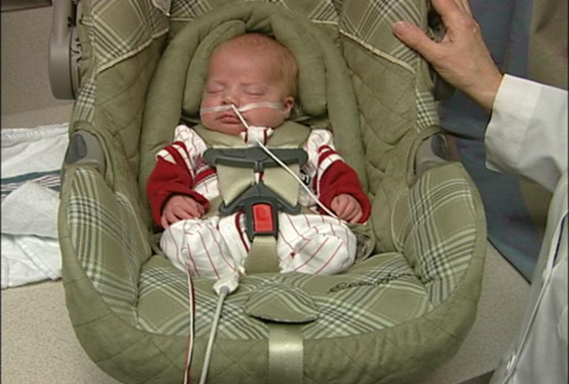
Rear-Facing Only Car Seats
Only installed rear-facing
Lower weight range 3-5 pounds
Upper weight range 22-35 pounds
May be useful for children with:
  Prematurity/Low birth weight
  Low muscle tone
  Respiratory issues
Helpful features:
  Positioning inserts/extra padding
  Multiple harness slots and crotch strap positions
  Recline angle
Infant in rear-facing only car seat
Source: Automotive Safety Program
Notes:
Explain that rear-facing only car seats are the smaller seats with carrying handles. Most have detachable bases.
Explain that weights listed here are only general ranges. Car seat manufacturers determine specific weights and heights for their products. The weights and heights are on labels affixed to the shell of the seat and in the car seat instruction manual.
FYI
Please note: this in-service does not include details about observing premature and other at risk infants in car seats prior to discharge. There is a hidden slide at the end of the in-service that provides more information if participants ask for questions.
You can also refer participants to the Resources handout that is in the tool kit. It contains a link to the American Academy of Pediatrics clinical report, Safe Transportation of Preterm and Low Birth Weight Infants at Hospital Discharge.
It provides guidelines for pediatricians and other caregivers who counsel parents about car safety seats for preterm and low birth weight infants.
http://pediatrics.aappublications.org/content/123/5/1424
The baby in the photo was born at approximately 25 weeks. In this photo, he is ready for discharge; weighs about 7 pounds; and is positioned in a child safety seat designed with a positioning support system for small babies.

Slide 16
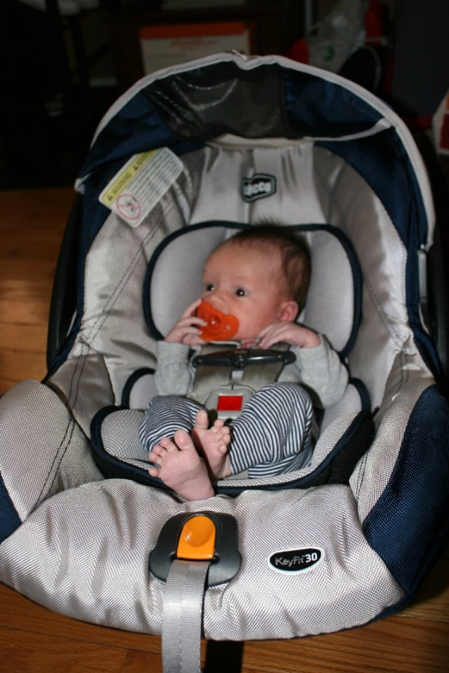
Positioning Infants
Use only infant inserts and padding that come with that specific car seat
Do not add any non-regulated products to car seat
Some inserts specifically for smaller babies
Some inserts must be removed at a specified weight
Infant in rear-facing only seat
Source: Automotive Safety Program
Notes:
Point out the infant positioning inserts, which came with the car seat, and are therefore safe to use.

Slide 17
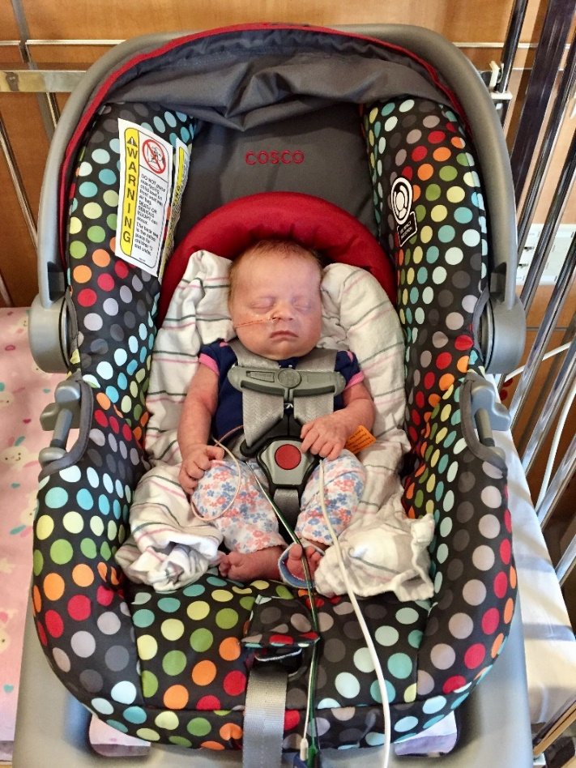
Positioning Infants
If allowed by the car seat manufacturer
  Blanket rolls along sides for stable positioning
  Blanket rolls outside of harness
  Crotch rolls may also be used to prevent slouching
Do not add any padding under or behind baby that did not come with the car seat
Infant born preterm with rolled receiving blankets for support
Source: Automotive Safety Program
Notes:
Explain that some car seats do not come with extra positioning inserts or the inserts provided do not sufficiently support the baby. The baby in this photo was born prematurely and getting ready for discharge at 5.5 lbs. She was in a car seat that did not come with adequate positioning inserts or head pads. Rolled receiving blankets were placed along her sides to keep her centered in the seat. Crotch rolls may also be used to prevent slouching if allowed by the child restraint manufacturer.
When using this method, make sure it is not contraindicated by the car seat manufacturer.
This method is recommended by the American Academy of Pediatrics in Safe Transportation of Preterm and Low Birth Weight Infants at Hospital Discharge.
http://pediatrics.aappublications.org/content/123/5/1424
FYI
A similar method of positioning may be necessary to provide lateral support for older children in forward facing seats. The blankets/towel rolls are placed outside of the harness.

Slide 18
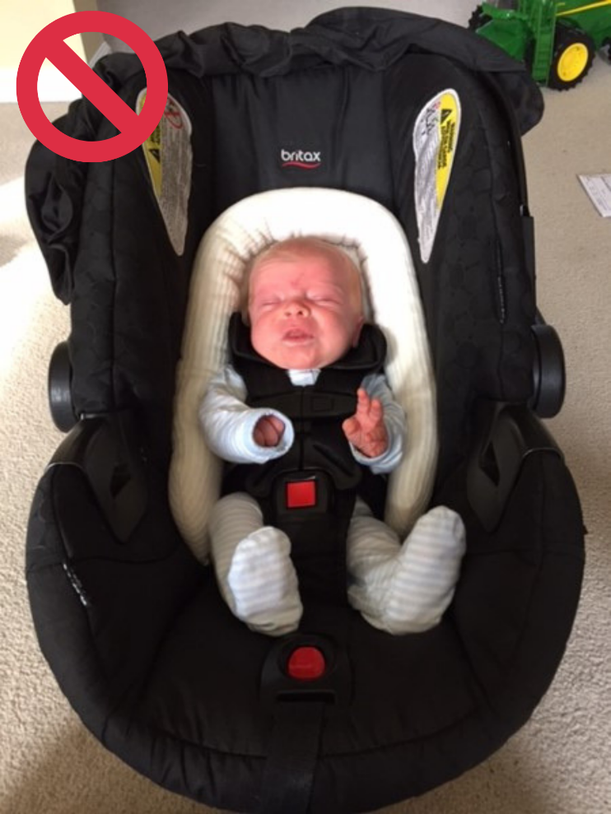
Adding Extras to Any Car Seats
Compromise integrity of car seat
Voids warranty of car seat
Impacts safety and overall performance of car seat
ONLY exception:
  Extra accessories made for the specific model of car seat by that specific car seat manufacturer
Infant with non-regulated
head support cushion
Source: Automotive Safety Program
Notes:
Explain that products might claim they meet applicable federal safety standards but no standards exist for these products.
The positioning device shown in the picture adds padding behind the infant and displaces the harness compromising the protection provided by the seat.
The only accessories allowed are those made by a car seat manufacturer for a specific model of car seat.

Slide 19
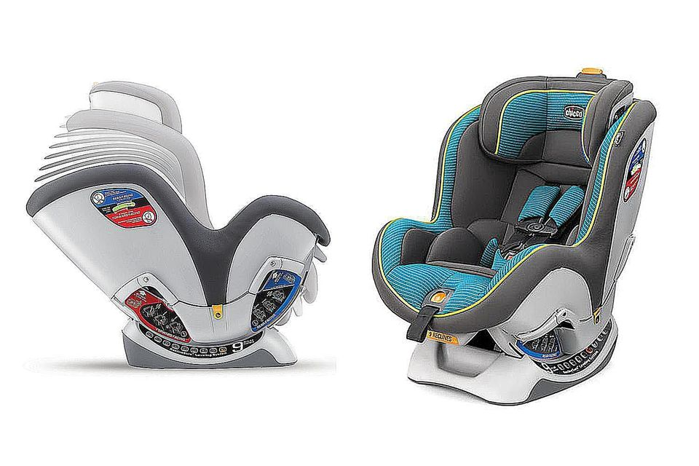
Convertible Car Seats
Converts from rear-facing to forward-facing seat
Rear-facing:
  Lower weight range 3-5 pounds
  Upper weight range 40-50 pounds
Forward-facing:
  Lower weight range 20-25 pounds
  Upper weight range 40-65 pounds
  2 years of age for some models
  All-in-one car seats convert from rear-facing to forward-facing and then to booster seat
Source: www.thespruce.com
Notes:
Explain briefly the major changes made to a convertible seat:
Recline angle
Harness slots
Seat belt path
In addition to weight and height guidelines, explain that some manufacturers specify that a child has to be 2 years old before riding forward facing.
Combi Cocorro 3-33# Rear Facing

Slide 20
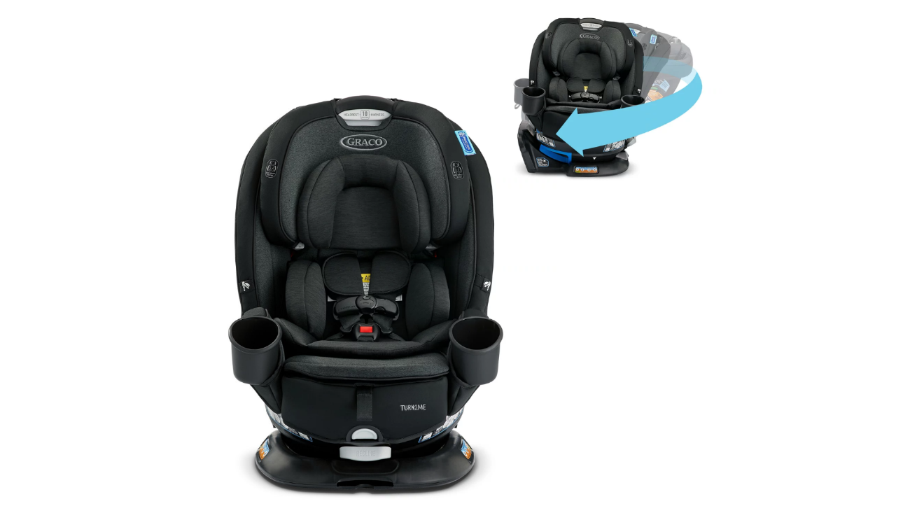
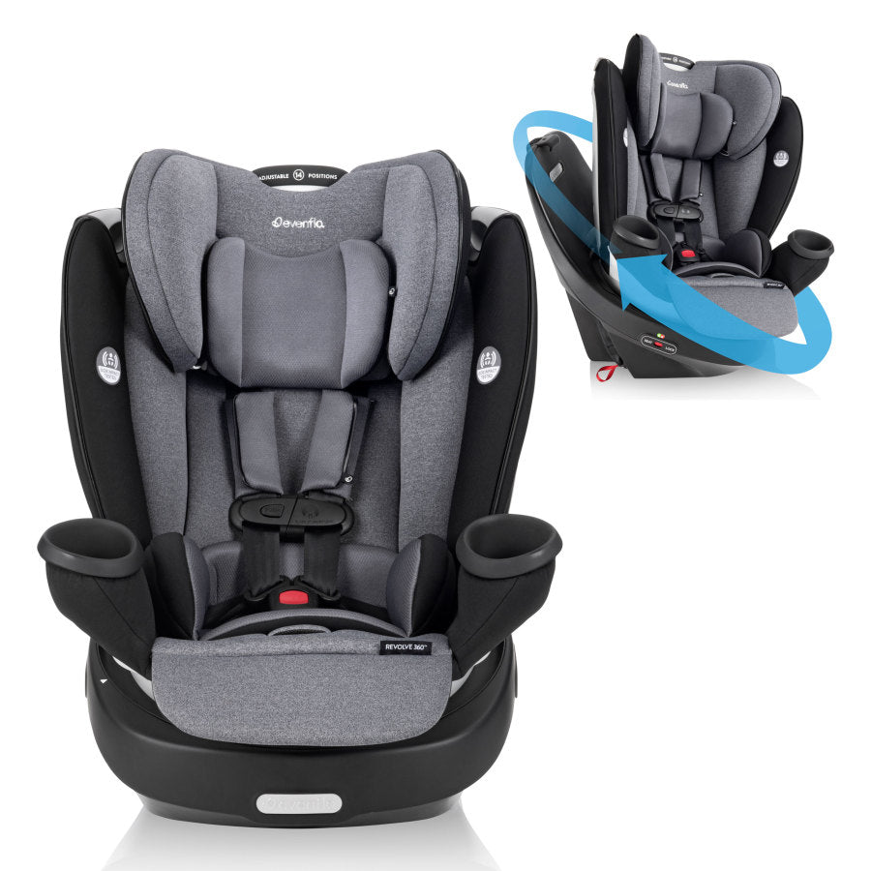
Rotating Convertible Car Seats
May encourage rear-facing for longer
May improve safety of transfers in and out of car seat
May be too expensive for some families
Graco Turn2Me
Source: Graco
Evenflo Revolve
Source: Evenflo

Slide 21
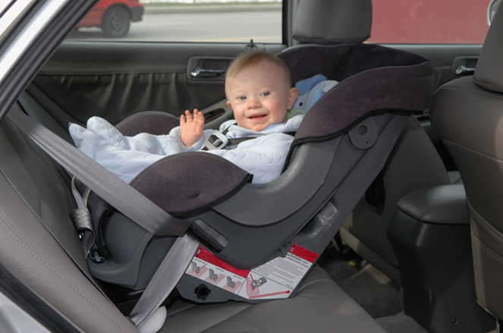
Convertible Rear-Facing Car Seats
Rear-facing up to the highest height or weight allowed by manufacturer
  Car seat shell supports body along entire head and back; and provides protection especially to spine in crash situation
May be useful for children with:
  Smaller stature
  Developmental delays
  Brittle bones
  Down syndrome
  Low tone
  Breathing issues
Helpful features:
  Rear-facing more protective
  Rear-facing multiple recline options
  Extra padding and inserts
Child with diagnosis of Down syndrome in rear-facing convertible seat
Source: Automotive Safety Program
Notes:
Explain the benefits of rear-facing:
In a frontal crash, the head of a child who is riding forward facing moves abruptly forward placing increased force on the neck. This can increase the risk of neck and spine injuries, especially in infants, young toddlers and children with special health care needs.
A rear-facing car seat supports the entire head, neck and back of a child in a frontal crash. The shell of the car seat absorbs the force of the crash. When a child is properly restrained rear-facing, the head moves with the seat reducing the risk for neck and spine injuries.
Since rear-facing car seats are installed semi-reclined, the recline angle helps keep a child’s head back, which is beneficial for children with breathing problems and low tone.
Explain that children easily cross their legs and put them on the seat back. In fact, injuries to legs are less frequent rear-facing than forward-facing and main concern is protection of head, neck, and spine, which are best protected by forces absorbed along the entire back of the car seat.
FYI
The child in the photo is 18 months old, weighs approximately 20 pounds and has Down syndrome. This child will be seen again in the case studies.

Slide 22
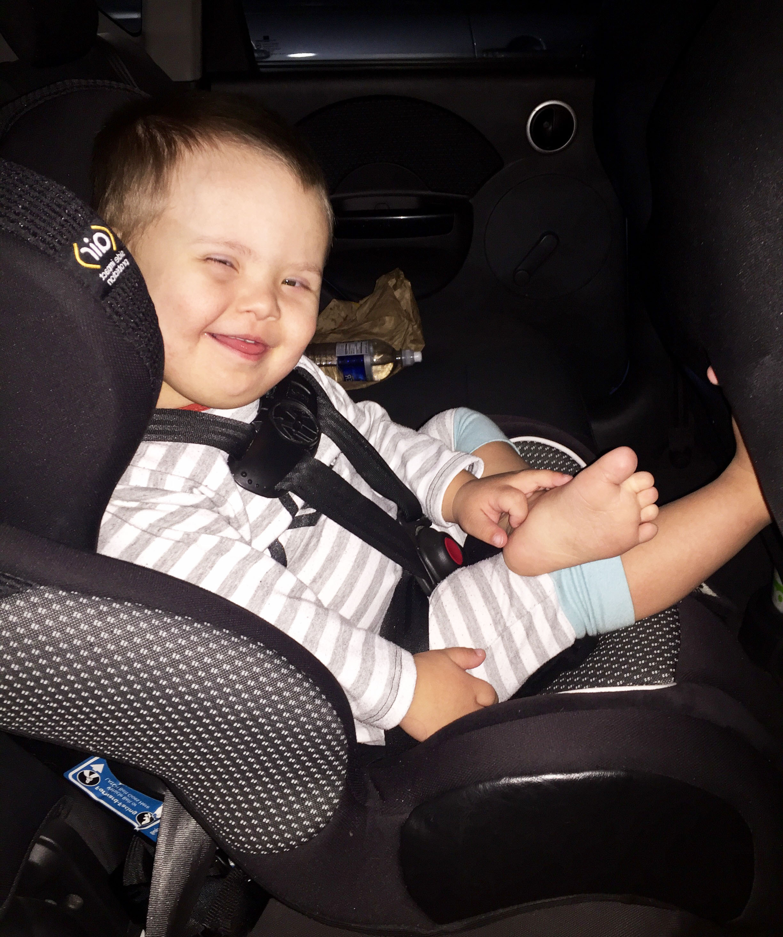
Convertible Forward-Facing Car Seats
5-point harness absorbs crash forces
Minimum age of 2 years old required for some models
May be useful for children with:
  Neuromuscular disorders
  Bone dysplasia conditions
  Hydrocephalus
  Behavioral issues
  Overweight or obese
Helpful features:
  Higher harness weights – up to 65 pounds
  Forward-facing multiple recline options
  Lateral and adjustable head supports
Child who is 3 years with diagnosis of Down syndrome in
forward-facing convertible seat
Source: Automotive Safety Program
Notes:
FYI
Conventional forward-facing child restraints with higher weight harnesses are a valuable asset to car seat programs as they may provide an interim transportation solution for the child with special health care needs while funding is obtained for a large medical seat.
Seats with lower or shallow sides may accommodate children in long-leg broomstick or hip casts (IF ALLOWED BY MANUFACTURER).
Forward-facing seats that have recline features may assist with positioning children with poor head and neck control who have outgrown their rear-facing car seat.
Seats with more padding and positioning inserts can provide better positioning or comfort for children with neuromuscular or bone dysplasia conditions.
The child shown in the picture is 3 years old, weighs 37 pounds and has Down syndrome. Considerations would be given to family regarding keeping the 3 year old rear-facing longer given age, weight and size.

Slide 23
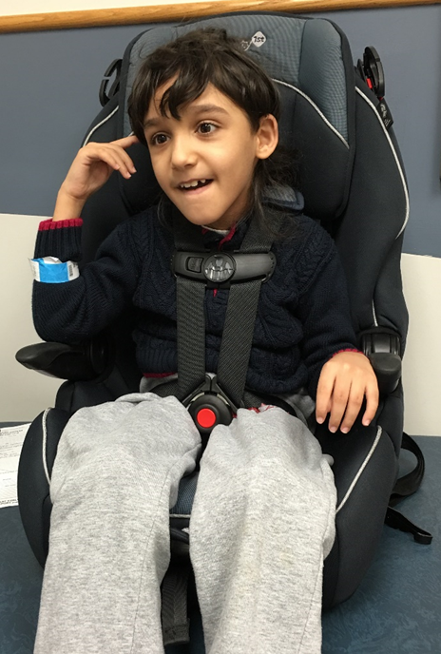
Combination Car Seats
Changes from car seat with harness to booster by removing harness and using lap-and-shoulder belt over child
Weight and height ranges for harness mode different than booster mode
Harness mode:
  Lower weight range 22-30 pounds
  Upper weight range 40-65 pounds
  Child must be 2 or 3 years old for some models
  Belt Positioning Booster
  Lower weight 40 pounds
  Upper weight range 100-120 pounds
  Stay in booster up to 57 inches
  Child must be 4 years old
Child with diagnosis of cerebral palsy in combination car seat
Source: Automotive Safety Program
Notes:
Uses and helpful features of combination car seats in harness mode are similar to those of convertible car seats used forward-facing. They are also an interim solution while waiting for insurance or Medicaid approval for a larger adaptive restraint.
FYI
For some children, towel rolls may be necessary to provide more lateral support and/or a soft cervical neck collar to help hold the head upright. Added padding and/or collars must be outside the harness system.
The child in the photo is 8 years old, weighs 40 pounds and has cerebral palsy.

Slide 24
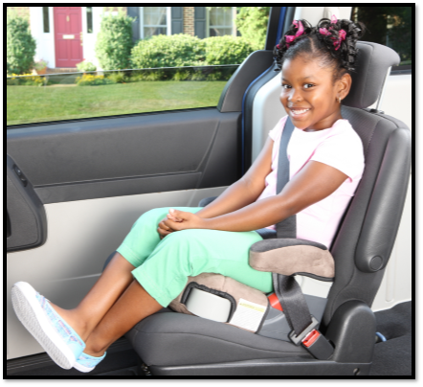
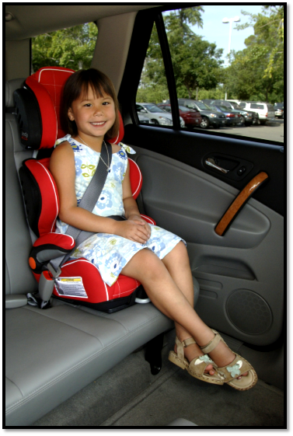
Booster Seats
“Boosts” child up so seat belt fits
Requires lap-and-shoulder belt
Lower weight range 30-50 pounds
Upper weight range 100-120 pounds
Minimum age of 3 or 4 years for some boosters
High-back or backless models
May be useful for:
  All children until seat belt fits
  Children smaller than typically developing peers
  Larger children who experience intermittent fluctuations with head, neck, and trunk control
Backless Booster
Source: NHTSA Image Library
High-Back Booster
Source: NHTSA Image Library
Notes:
FYI
Extended booster seat use is recommended for children who are smaller than their typically developing peers, such as children with achondroplasia, a form of dwarfism.
High back boosters with sides may provide adequate lateral support for some larger children who experience intermittent fluctuations with head, neck, and trunk control.

Slide 25
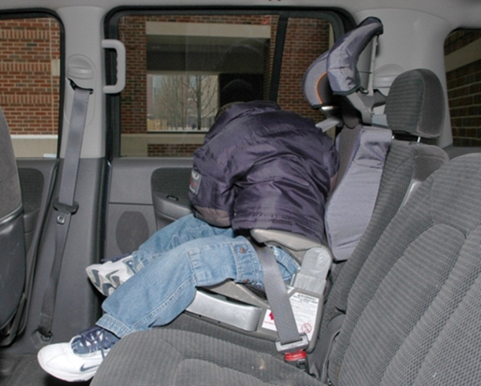
Booster Seats
Helpful features:
  Higher weight limits
  High back models with lateral support
  Adjustments that extend height and width
Requires good head, neck, and trunk control
Requires child to stay seated and buckled in vehicle lap-and-shoulder belt
Child in booster attempting to unbuckle seat belt
Source: Automotive Safety Program
Notes:
FYI
In order to use a booster seat, a child needs good head, neck and trunk control.
Since a booster seat does not restrict a child as much as a five-point harness, they are usually not the best choice for a child who has behavioral issues related to staying buckled up.

Slide 26
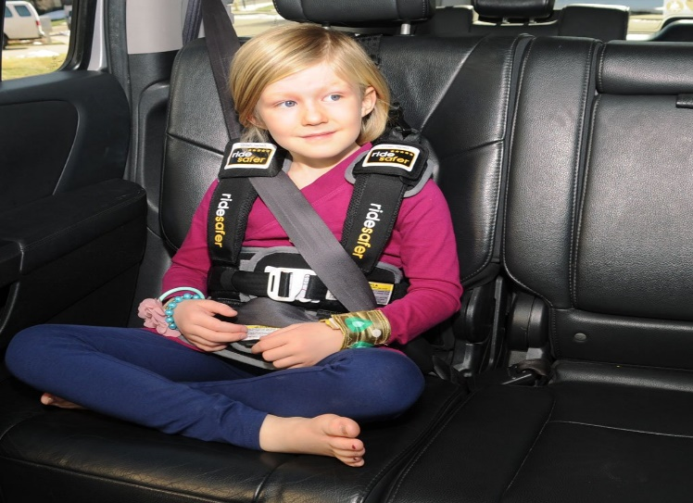
Vests
The Ride Safer Travel Vest is a conventional option for families with limited space or are travelling
Require lap-and-shoulder belt for crash protection
Provides trunk support
Uses tether anchor for installation
Some models for school buses
Source: Ride Safer
Notes:
FYI
Vehicle compatibility must be considered before ordering a vest since the E-Z-ON upright vest must be tethered.
A crotch strap is mandatory on smaller vests and recommended on bigger vests to minimize the risk of submarining.
You can find additional information at www.ezonpro.com.

Slide 27
adaptive restraints
Notes:
This is just a section header slide.

Slide 28
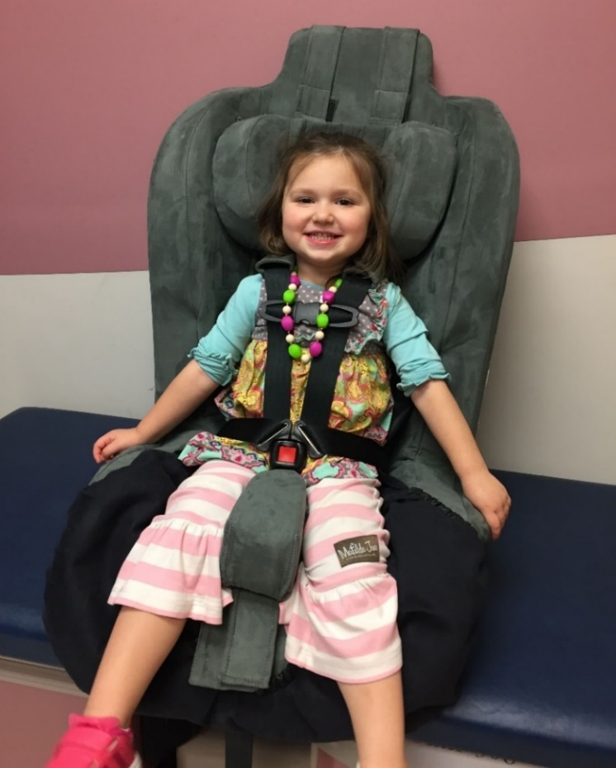
Adaptive Restraints
First – Always start with conventional car seats
Adaptive restraints are designed for children who:
  Are unable to use conventional harness system
  Have outgrown conventional car seat and require additional postural support
  Must lie down
  Demonstrate severe behavioral challenges/escaping/unbuckling
Child with diagnosis of sensory processing disorder in large medical seat
Source: Automotive Safety Program
Notes:
Explain that although conventional seats should be used if possible, adaptive restraints are necessary for some children.
FYI
In order to use a conventional seat, a child must be able to bend at the hips with the child’s back and bottom all the way back in the car seat. Children with hip casts often are unable to bend at the hips and require a adaptive restraint.
Some children may have abdominal abnormalities that could be aggravated or injured by a five-point harness. These children need a restraint with a adaptive harness or securement system.
Children with poor head and trunk control require the support of an adaptive restraint after they have outgrown a standard car seat.
Children with severe behavioral problems who are able to “escape” their restraint may need an adaptive restraint with “anti-escape” features.
The child shown in the picture is a 3 year old with severe sensory processing disorder.

Slide 29
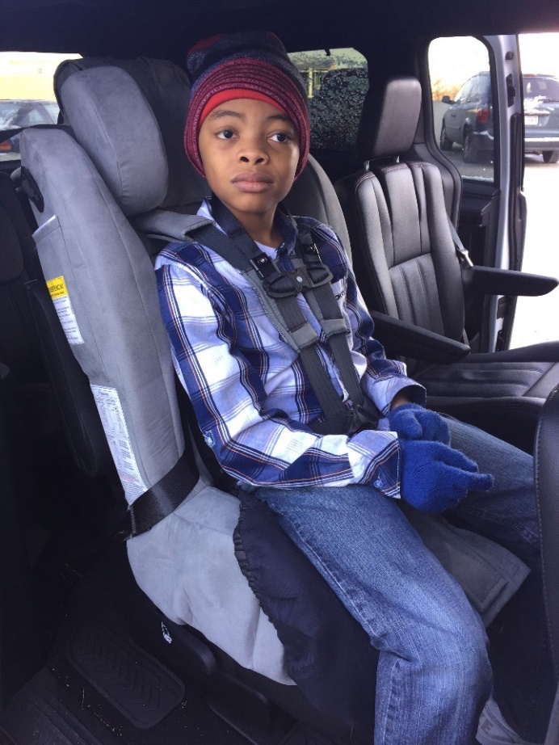
Adaptive Restraints
Not readily available
More expensive than conventional seats
May be available through hospital loan, purchase, or give-away programs
Often require a therapist evaluation and Letter of Medical Necessity
Ordered through local durable medical equipment (DME) providers or directly from the manufacturer
Child with diagnosis of autism in large medical seat
Source: Automotive Safety Program
Notes:
FYI
Adaptive restraints cannot be purchased at retail stores.
They have to be ordered from child restraint vendors, directly from the manufacturer or from durable medical equipment providers. These seats can costs thousands of dollars. Seats fluctuate in cost from online purchase to DME provider prices.
Third-party payers may cover cost with proper documentation, such as a letter of medical necessity (LMN). It typically takes 2-3 months to take ownership of seat when going through insurance. A sample letter of medical necessity is included in the tool kit materials.
Some hospitals loan adaptive restraints that are used short term, such as car beds.
The child in the picture is 10 years old and has autism. He is restrained in a large medical seat that has an anti-escapism chest clip and buckle.

Slide 30
Types of Adaptive Restraints
Car Beds
Jefferson Car Seat
Adaptive Restraints for Casts
Large Medical Seats
Adaptive Booster Seats
Adaptive Vests
Notes:
Explain that since some of these restraints are one-of-a kind, they are mentioned by name.
Inclusion in this presentation does not imply product endorsement.

Slide 31
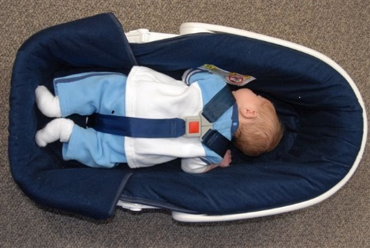
Car Beds
For infants and younger children who must lie down
Prone positioning requires physician’s written order
May be useful for children with:
  Preterm birth
  Low birth weight
  Respiratory issues
  Brittle bones
  Low muscle tone
  Some casts
Infant with diagnosis of Pierre Robin Sequence positioned prone in car bed per physician’s written order
Source: Automotive Safety Program
Notes:
FYI
Babies discharged in car beds should have a period of observation in the car bed prior to discharge to ensure placement in the car bed will not exacerbate any of the babies’ symptoms.
Additionally, when the physician determines the baby may be able to ride semi-upright, a follow-up period of observation in a rear-facing child safety seat should be conducted to make sure the baby is ready to transition to a rear-facing position.
The baby shown in this picture has Pierre Robin Sequence, which is a congenital defect of the face characterized by abnormal smallness of the lower jaw and retro-positioning of the tongue with frequent obstruction of the airway.

Slide 32
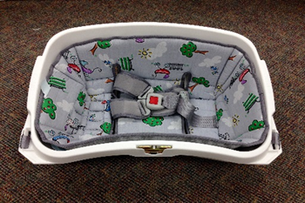
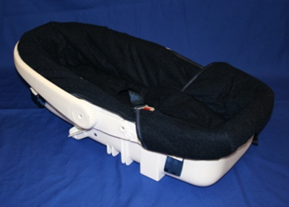
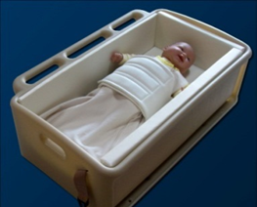
Car Beds
All car beds are installed lengthwise on vehicle bench seat with child’s head toward center of vehicle
Angel Ride
Less than 9 pounds
Less than 21.5 inches
Dream Ride
5-20 pounds
26 inches or less
Hope car bed
4.5-35 pounds
Up to 29 inches
32

Slide 33
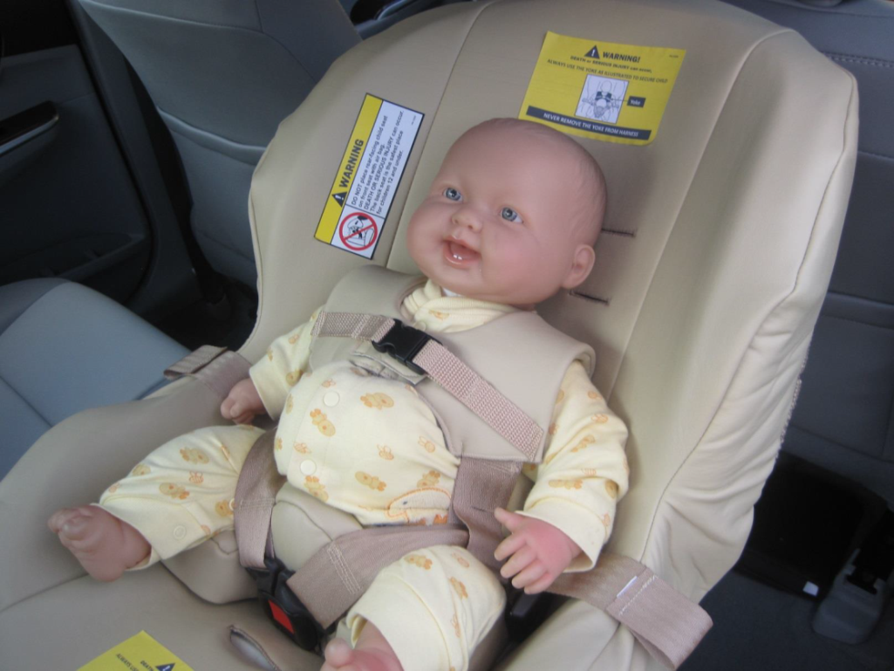
Jefferson
Rear-facing only
For children 7.5-40 pounds, 19-37 inches
Yoke harness design routes around the abdomen for omphaloceles
Buckle position prevents buckle/harness contact with omphalocele
Can be used for children without omphaloceles requiring yoke harnessing
Source: Merritt Manufacturing
Notes:
FYI
An omphalocele is a congenital abnormality, in which the abdominal contents are outside the abdomen in a sac, due to a defect in the development of the muscles of the abdominal wall.
The Jefferson is distributed by Merritt Manufacturing and designed for children with omphaloceles and used for children whose medical team has determined cannot tolerate a harness system directly on the omphalocele. The Jefferson has a yoke that routes the harness around the omphalocele. It was launched in the summer of 2013.
Although the CSS shell is that of a convertible seat, the Jefferson can only be used rear-facing. The forward-facing seat belt path has been blocked so that it cannot be used.
www.merrittcarseat.com

Slide 34
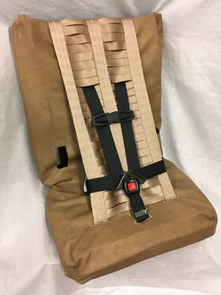
Adaptive Restraint for Casts
Convertible car seat designed for casts
  Rear-facing weight range 5-40 pounds
  Forward-facing weight range 25-80 pounds
  Height range: up to 60 inches
  Wallenberg designed for arm and leg casts
Wallenberg
Source: Merritt Car Seat
Notes:
Quokka Discontinued Jan 2023 - but may still be seen at car seat clinics until expirations

Slide 35
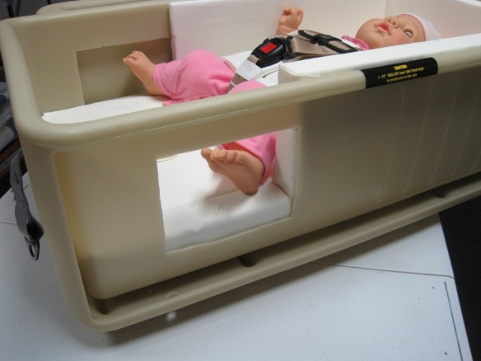
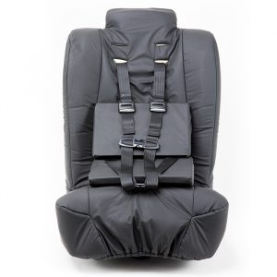
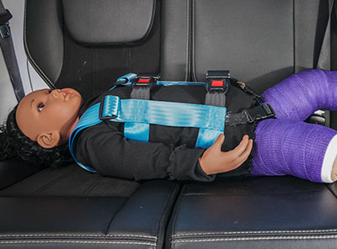
Adaptive Restraints for Casts
Hope Car Bed (if need to lie down)
Lay Down EZ-ON Vest (if need to lie down)
Spirit Spica (forward-facing only)
Source: Merritt Car Seat
Source: Inspired by Drive
Source: EZ-ON

Slide 36
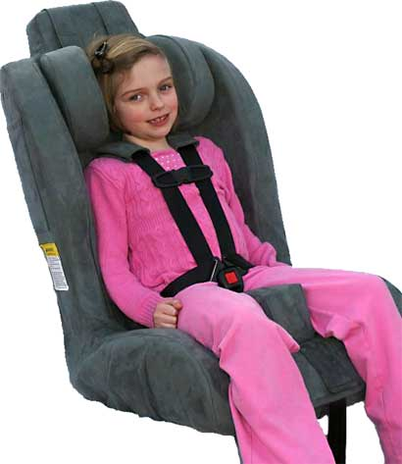
Large Medical Seats
Forward-facing only
Lower weight range: 20-35 pounds
Upper weight range: 102-130 pounds
Height range: 33.5-66 inches
5-point harness is for crash protection
May be useful for children with:
  Neuromuscular conditions
  Scoliosis
  Behavioral challenges
  Obesity
Large medical seat
Source: Merritt Manufacturing
Notes:
Large medical seats are similar to forward-facing car seat with harnesses. They have a shell, a harness system for restraining an occupant, and must be installed.
FYI
Manufacturers of large medical seats that exceed the weight limits of FMVSS 213 often crash test their products with larger crash test dummies according to 213 injury criteria.
Due to the size of the seats and size of occupants permitted, large medical seats require use of top tethers (sometimes two pre-installed tether anchors or heavy duty tether anchors), so vehicle compatibility must be considered before ordering large medical seats.
Often, the best approach is to have multiple seats available to see what works best for a specific child.
Commonly used large medical seats include:
The Roosevelt
IPS Seat
Spirit/Spirit Plus
Special Tomato
Defebder Reha

Slide 37
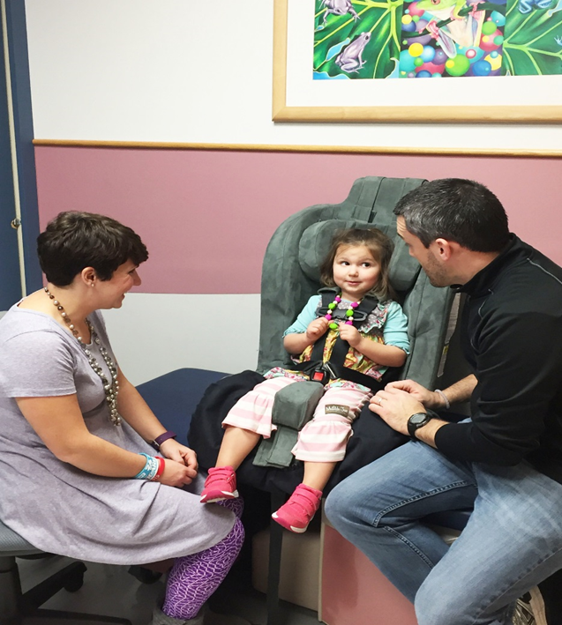
Large Medical Seats
Standard and optional accessories to aid positioning:
  Abductor wedges
  Seat extenders
  Head supports
  Anti-escape features available on specific large medical seats
Often require therapist evaluation
Order through DME company
Could take months for insurance approval
Occupational therapist working with family
Source: Automotive Safety Program
Notes:
FYI
Large medical seats offer accessories that can assist with a child’s specific positioning needs. When ordered, a rehabilitation therapist will determine which accessories best meet a child’s needs. Some accessories come as standard features while others must be ordered separately for an additional amount. Examples of accessories include head support cushions, abductor wedges, seat extenders to accommodate growth, extra padding, lap trays, foot rests, escapism features, turning bases, etc. It’s important to note that not all large medical seats offer the same type of accessories and that their accessories are not interchangeable.
Obtaining a large medical seat for a family can be a lengthy process, taking up to three to six months or longer. Typically, a physician will write an order for an OT or PT evaluation; a vendor is selected by the family after the evaluation and selection of a restraint; a letter of medical necessity (LMN) detailing why the child needs the restraint is written by the physician or therapist and provided to the vendor; the vendor submits the LMN to the family’s third-party payer for approval. If the restraint is approved, the vendor is able to order it and eventually deliver it to the family or institution. Ideal delivery will be by the therapist who completed evaluation to ensure proper fitting, adjustments and installation.
Rehabilitation therapists are able to charge for their car seat evaluation.

Slide 38
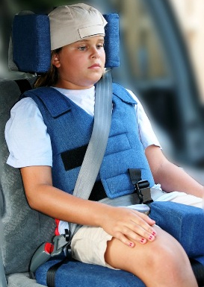
Adaptive Booster Seats
Forward-facing only
Lower weight range: 30-80 pounds
Upper weight range: 102-175 pounds
Height range: 37-72 inches
Require lap-and-shoulder belt over child for crash protection
Positioning harness or positioning vest for postural support
May be useful for children with:
  Neuromuscular conditions
  Scoliosis
  Behavioral challenges
  Obesity
Adaptive booster
Source: Merritt Manufacturing
Notes:
FYI
Accessories for adaptive booster seats vary, based on the manufacturer, and are not interchangeable between seats.
Although adaptive boosters are not installed in the same way as large medical seats, some require the use of tethers and lower anchors. Vehicle compatibility must be considered before ordering adaptive booster seats.
Commonly used adaptive booster seats include:
Recaro Monza Nova 2 Reha
Convaid Carrot 3 Car Seat
Convaid Carrot Booster Seat
Pilot
The Churchill

Slide 39
Adaptive Booster Seats
Standard and optional accessories to aid positioning:
  Abductor wedges
  Seat extenders
  Head supports
  Anti-escape features available on specific adaptive boosters
Often require therapist evaluation
Order through DME company
Could take months for insurance approval
Adaptive booster
Source: Merritt Manufacturing
Notes:
FYI
Accessories for adaptive booster seats vary, based on the manufacturer, and are not interchangeable between seats.
Although adaptive boosters are not installed in the same way as large medical seats, some require the use of tethers and lower anchors. Vehicle compatibility must be considered before ordering adaptive booster seats.
Commonly used adaptive booster seats include:
Recaro Monza Nova 2 Reha
Convaid Carrot 3 Car Seat
Convaid Carrot Booster Seat
Pilot
The Churchill

Slide 40
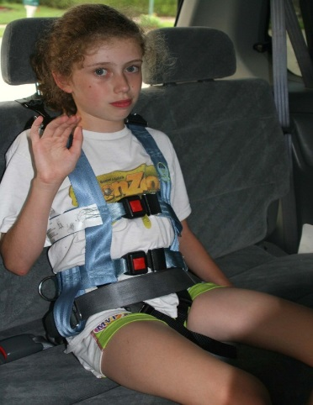
Adaptive Vests
Seated upright options
  Lower weight range: 31-81 pounds
  Upper weight range: 168-225 pounds
  Height range: up to 72 inches
Require lap-and-shoulder belt over child for crash protection
Positioning vest or positioning harness for postural support
EZ-ON Vest
Source: Automotive Safety Program
Notes:
FYI
Vehicle compatibility must be considered before ordering a vest since the EZ-ON upright vest must be tethered.
A crotch strap is mandatory on smaller vests and recommended on bigger vests to minimize the risk of submarining.
You can find additional information at www.ezonpro.com.

Slide 41
Adaptive Vests
Provide trunk and pelvic support
Installed with tether and often with lower anchors attachments
May be useful for children with:
  Neuromuscular conditions
  Scoliosis
  Obesity
Often require therapist evaluation
Order through DME company
Could take months for insurance approval
Chamberlain adaptive vest
Source: Merritt Manufacturing

Slide 42
Lay Down EZ-ON Vest
May be useful for any child who must lie down during transportation
Often needed with body casts, hip spica casts, braces, etc.
Often loaned/provided for child needing temporary option
Child must fit lengthwise on bench seat (legs can bend)
Up to 2 inches of padding allowed under child
Source: EZ-ON
Notes:
Explain that, at this time, the Lay Down EZ-On vest (previously the modified E-Z-ON vest) is the only product designed for older children who must lie down. The manufacturer recommends adding padding at the child’s head and feet.
FYI
You can find additional information at www.ezonpro.com.

Slide 43
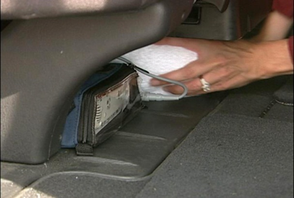
Medical Equipment
Families must travel with prescribed medical equipment
No specific product available for securement of equipment in a vehicle
Keep equipment as low as possible to not become a projectile
Secure by placing on floor of vehicle wedged with pillows, foam, or blankets or with buckle into adjacent, unoccupied seat belt
Check vehicle manual about placing items under vehicle seat (as some newer vehicles have air bag sensors that can be affected)
Apnea monitor being wedged under vehicle seat
Source: Automotive Safety Program
Notes:
FYI
Some children are required to use medical equipment such as apnea monitors, oxygen and suction during transport. To date, there are no products available to secure medical equipment in a vehicle.
To minimize the risk of equipment becoming projectiles, recommendations include securing the equipment by wedging it under a vehicle seat, putting padding around it or using an unoccupied, adjacent seat belt.
It is important to check the vehicle owner’s manual to see if placing items under the vehicle seat or touching it is allowed. Some vehicles prohibit it due to potential compromise of air bag sensors.

Slide 44
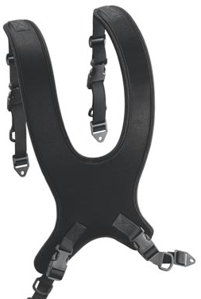
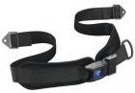
Wheelchair Transportation
Child is safer if transferred from the wheelchair to a conventional or adaptive restraint in vehicle.
If a child is staying in wheelchair during transportation:
  Wheelchair must be attached to appropriate wheelchair tie-down system at securement points
  Child must have vehicle lap-and-shoulder belt for crash protection
Postural pelvic belt
Source: AEL
Dynaform postural harness support Source: AEL
NOTE: No postural harness supports and very few pelvic belts are crash tested. WC-19 information will be on a crash tested pelvic belt. Vehicle lap-and-shoulder belts are required.

Slide 45
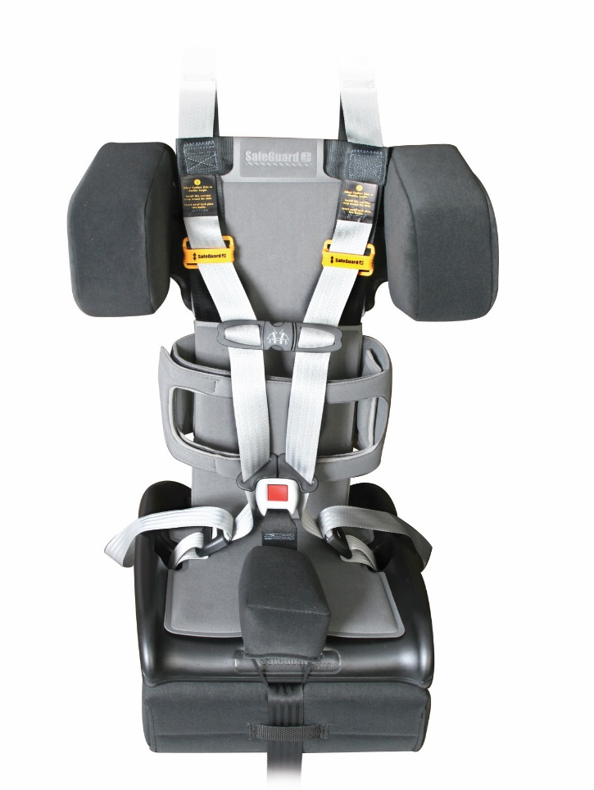
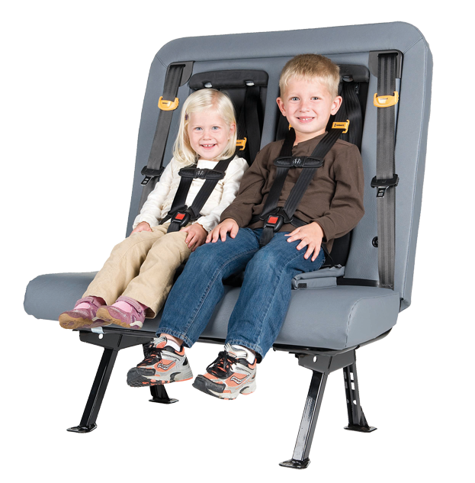
School Bus Restraints
Restraint options :
  Integrated bus seats
  Conventional restraints
  Adaptive restraints
  School bus specific restraints
Availability of seat belts on bus affects restraint selection
Some restraints attach to school bus seat without seat belt
Adaptive school bus seat
with torso support and integrated bus seat
Source: IMMI
Notes:
FYI
Federal regulations mandate the right of a child with special health care needs to access equal services, including transportation to and from school.
Transportation needs, including specifics about how the child should be restrained, should be documented in the child’s Individual Education Plan (IEP). This is a written plan of strategies and activities for the provision of educational services and programs for students with disabilities. If transportation is designated as a related service, a transportation representative should be a member of the IEP planning team.
Restraint selection may be determined based on the availability of seat belts on a bus. School buses 10,000 pounds and under are required to have seat belts that meet applicable federal motor vehicle safety standards. Buses over 10,000 pounds are not required to have seat belts. Some restraints must be installed with seat belts and others have installation straps that wrap around the back of the school bus seat and attach to the restraint.
The restraint shown is the STAR school bus seat from IMMI. http://www.imminet.com/industries/school-bus/school-bus-safeguard

Slide 46
Case Studies
Notes:
Explain that these simple case studies require participants to decide if a conventional or an adaptive restraint is needed. Participants do not have to name a particular brand or model of restraint, just a general category such as rear-facing conventional seat, car bed or large medical seat.

Slide 47
Conventional or Adaptive Restraint?
Infant who must travel prone

Slide 48
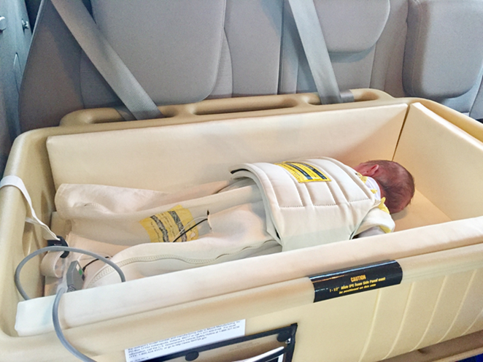
Adaptive Restraint
Car bed that allows prone positioning (with physician’s written order)
Source: Automotive Safety Program
Notes:
Explain that there are no conventional child restraints that can accommodate a baby who must travel lying down. In this case, a car bed is necessary.
FYI
The baby in the picture is 3 weeks old with myelomeningocele. The child is traveling prone in the Hope car bed to prevent pressure being placed on the surgical site. This car bed offers a “restraint bag” that can be used instead of a harness to secure the child.
Myelomeningocele or spina bifida is a birth defect of the spine resulting from abnormal closure of the neural tube during early formation of the central nervous system. At the location of the opening, nerve development is adversely affected and the formation of bone, muscle and skin around the spinal cord is affected. A sac, called a cele, is created at the opening. The cele can be covered by a thin layer of nerve tissue and sometimes by skin. The location of the cele determines the extent of nerve damage. In general, the higher the location of the cele, the more nerves are involved and the greater the damage.

Slide 49
Conventional or Adaptive Restraint?
Child who is 4 years old, has diagnosis of autism, and weighs 37 pounds
The child has also escaped every conventional car seat and booster seat the family has tried

Slide 50
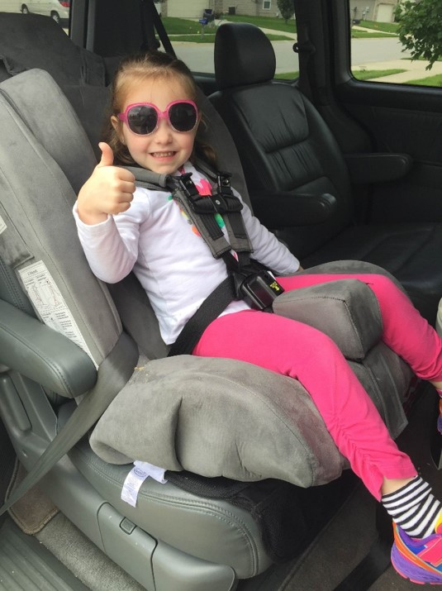

Adaptive Restraint
Large medical seat with anti-escape features to prevent child from unbuckling harness
Source: Automotive Safety Program
Notes:
FYI
The large medical seat shown is the Roosevelt by Merritt Manufacturing. Merritt Manufacturing is one of the few large medical seats to offer anti-escapism features. These accessories can only be used with the Roosevelt.
Top oval shows the locking chest clip with plastic key feature. This also has a strap that goes behind the child’s neck to prevent the chest clip from being pulled down, as well as a lock to prevent unbuckling.
Lower oval shows the buckle guard. This feature has an opening for a “key” (plastic post) in the middle and an opening at the bottom to allow caregivers access to the button for unbuckling, but occupants are unable to reach the required angle to unbuckle themselves.
These particular anti-escapism features are exclusive to the Roosevelt large medical seat.

Slide 51
Conventional or Adaptive Restraint?
Child who is 18 months old, has diagnosis of Down syndrome, and weighs 20 pounds
Child also has reduced muscle tone, and hypermobile, loose ligaments

Slide 52
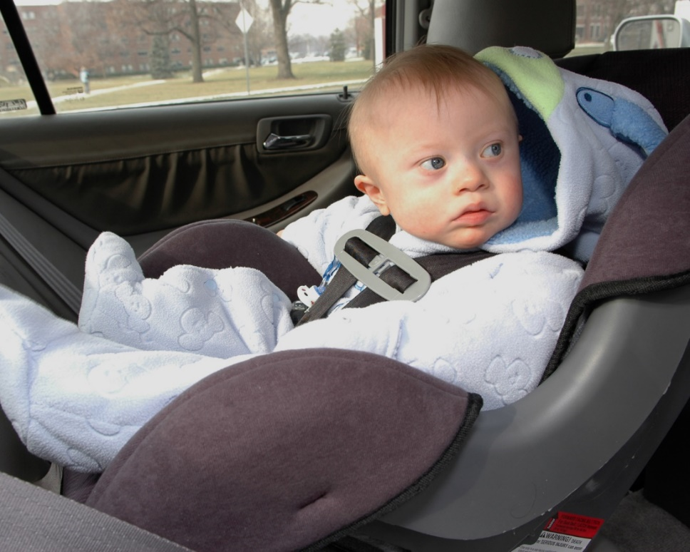
Conventional Restraint
Conventional rear-facing car seat
Source: Automotive Safety Program
Notes:
Explain that a rear-facing car seat will be the best option for this child. The back of the car seat will support the child’s head, neck and back.
FYI
Although the car seat shown is outdated, the concept of rear-facing longer for children with special health care needs remains the same. The National Center has not replaced this photo with a newer one to date.

Slide 53
Next steps and resources
Notes:
FYI
This is a section header slide.

Slide 54
Next Steps
Identify child passenger safety services in your facility and community
Review your facility discharge policies and protocols
Identify in-house and local child passenger safety technicians (CPSTs)
Identify those CPSTs who have taken the Safe Travel for All Children course
Identify individuals to want to become CPSTs and attend the NHTSA CPST training course

Slide 55
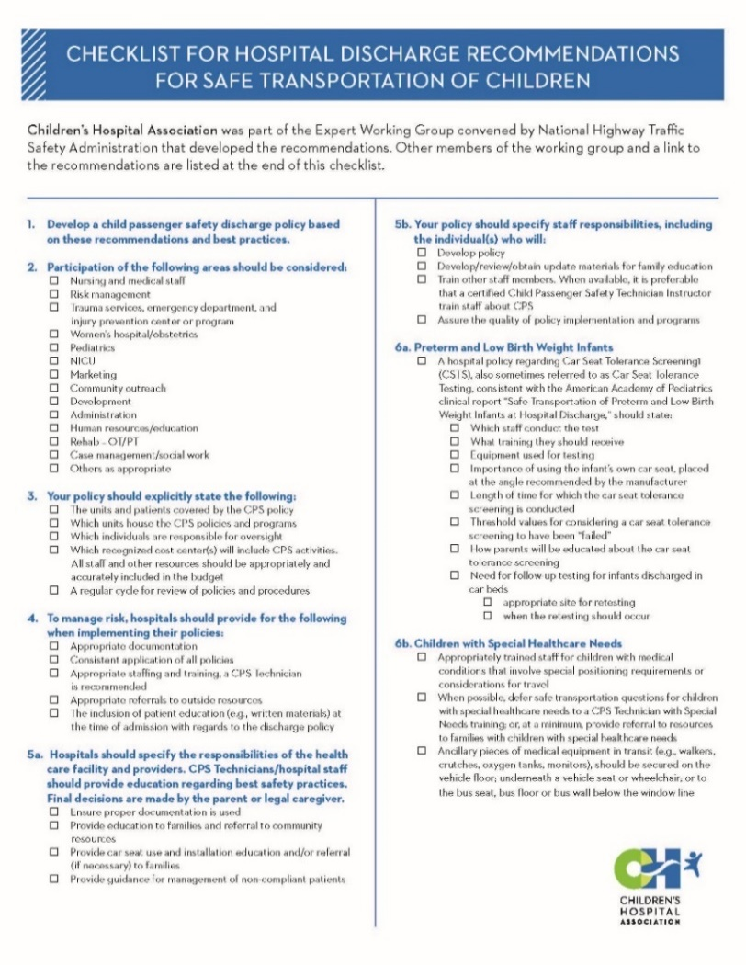
Hospital Discharge Recommendations
Comprehensive hospital discharge policy and protocol necessary to ensure safe travel
Recommendations from Expert Working Group:
nhtsa.gov/sites/nhtsa.dot.gov/files/documents/812106_hospitaldischrgerecsafetranschildren.pdf
Discharge checklist from Children’s Hospital Association
Notes:
FYI
The checklist from the Children’s Hospital Association is based on a more detailed document, Hospital Discharge Recommendations for Safe Transportation of Children.
The best practice recommendations were developed by an expert working group convened by the National Highway Traffic Safety Administration, March 25, 2014.
The expert work group included the National Child Passenger Safety Board, the National Highway Traffic Safety Administration, the National Safety Council, the Children’s Hospital Association and the American Academy of Pediatrics.

Slide 56
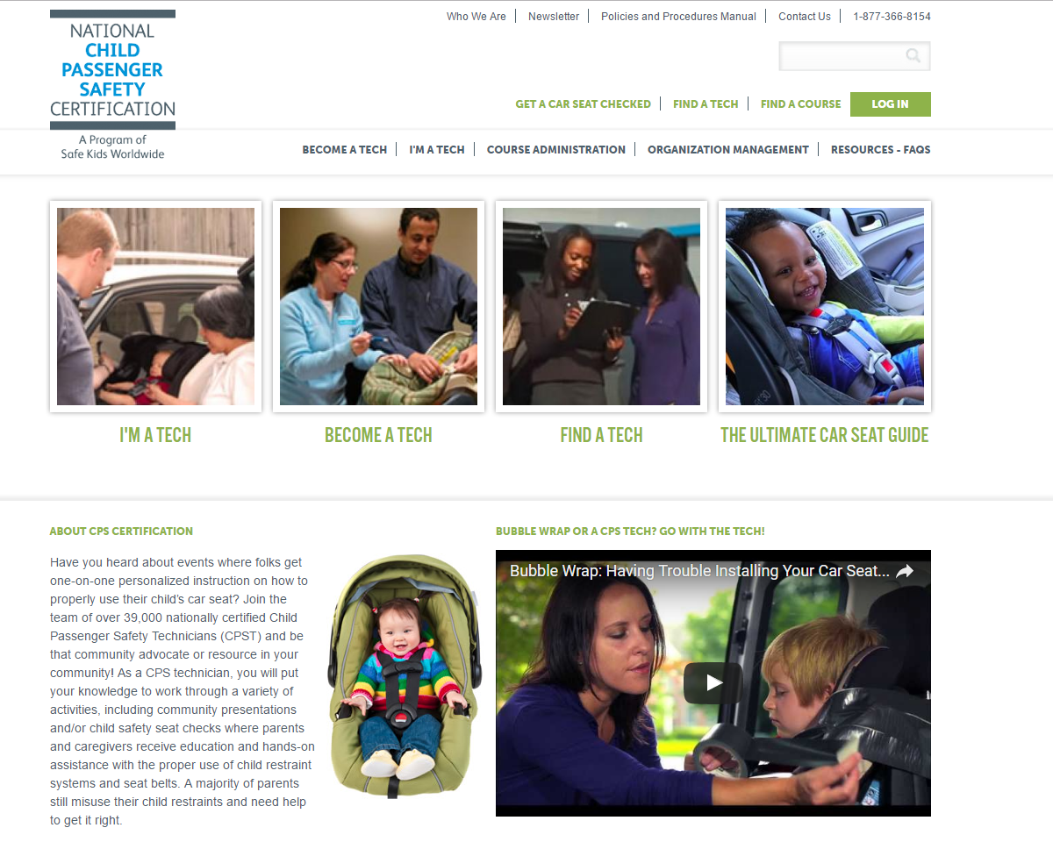
Become a Tech/Find a Tech/Find a Course
cert.safekids.org
Information about becoming a child passenger safety technician, finding trainings and technicians in your area
In the Find a Tech - Extra Training drop down box – click ‘Special Needs’ to find child passenger safety technicians who have taken the “Safe Travel for All Children- Transporting Children with Special Health Care Needs”
Notes:
You can search for CPSTs who have taken the adaptive training STAC course by clicking on the “Find a Tech.” On the search form, click on “Special Needs” in the Extra Training field.

Slide 57
AAP Car Seats: Product Listing for 2023
Conventional Car Seats - English and Spanish
Rear-Facing Only, Convertible, All-in-One, Combination, Booster
    Price Ranges
    Rear-Facing Weight Limits and Height Limits
    Forward-Facing Weight Limits, Height Limits, and Age Limits
    Booster Weight Limits, Height Limits, and Age Limits
    Recline Options in Forward-Facing
    Travel Vests
healthychildren.org/English/safety-prevention/on-the-go/pages/Car-Safety-Seats-Product-Listing.aspx

Slide 58

National Center for The Safe Transportation of Children with Special Health Care Needs
preventinjury.pediatrics.iu.edu
Information on adaptive transportation:
  Medical conditions
  Restraint options
  Trainings
  Research
  Brochures
1-800-755-0912
Notes:
FYI
The National Center for the Safe Transportation of Children with Special Healthcare Needs is housed under the Automotive Safety Program, Indiana University School of Medicine, Indianapolis, IN.

Slide 59
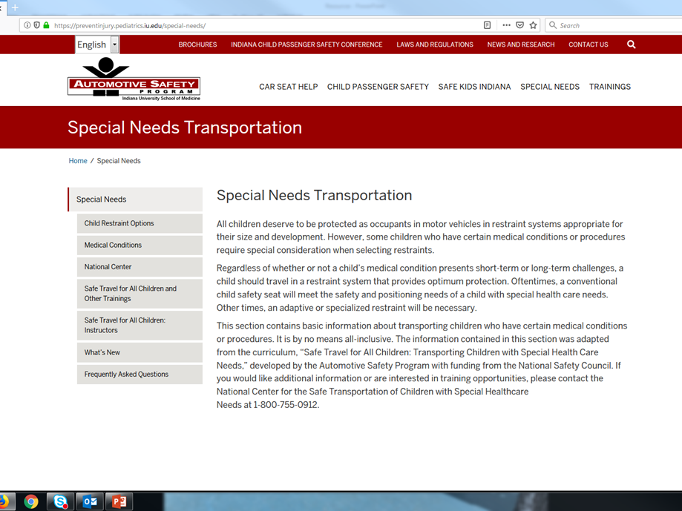
Safe Travel for All Children: Transporting Children with Special Health Care Needs
Enrichment course on adaptive transportation developed by the National Center
Two-day course
MUST be a CPST to take course
Courses all over the United States and beyond
Listing of upcoming courses at preventinjury.pediatrics.iu.edu/training/safe-travel-for-all-children/
Notes:
FYI
Safe Travel for All Children is an enrichment course for CPSTs. It combines classroom lectures and discussions with hands-on exercises. The training includes a proficiency skills check-off exercise that evaluates the participant’s ability to assess appropriate restraint devices and to demonstrate proper use and installation.
Information about the course as well as scheduled courses can be found at https://preventinjury.pediatrics.iu.edu.

Slide 60
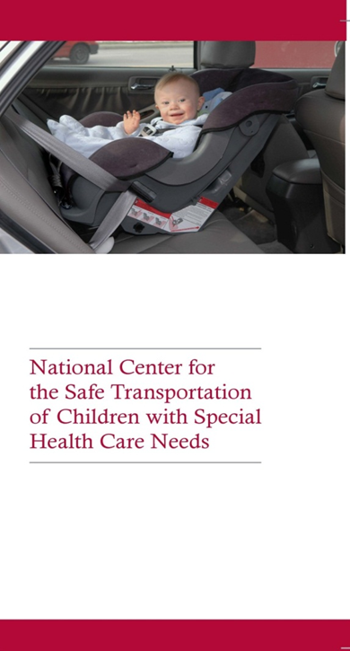
National Center Brochures
Available on website - free to download and print
preventinjury.pediatrics.iu.edu/brochures/
Main National Center brochure opens into poster of adaptive restraints with information
Diagnoses specific brochures related to transportation also available
Notes:
FYI
This brochure describes the services offered by the National Center for the Safe Transportation of Children with Special Health Care Needs. It opens into a poster of special needs restraints.
The brochure can be ordered free of charge from https://preventinjury.pediatrics.iu.edu . Quantities are limited to 20. It can also be downloaded directly from the website.
CPSTs are encouraged to order copies of the brochures to hand out during the in-service. It takes approximately 2-3 weeks for orders to be processed.

Slide 61
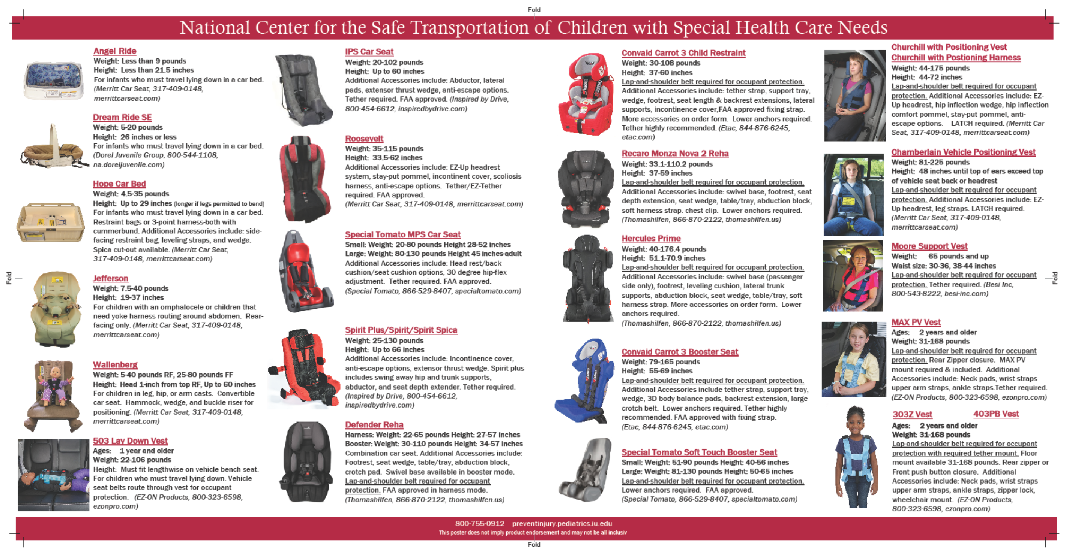
National Center Brochure

Slide 62
Questions?

Slide 63


Funding provided by Safe Kids Worldwide and Children’s National Health System

